Slide 1
Business Functions and Supply Chains
CIS 300: Computer Information Systems
Professor Matt Thatcher

Slide 2
Start Tegrity!

Slide 3
Reminders
Since Last Class Did You...?
  Read through BB materials!!
    https://blackboard.louisville.edu/webapps/login
  Purchase the course textbook (MIS, 6th Edition by Effy Oz)
  Play with Tegrity Classes after last class uploaded
  Form teams to complete the Homework Assignments
    Assignments may be turned in as Office 2007 or 2003 format!

Slide 4
Homework Assignment 1
Turn in Homework Assignment 1
  Assignment 1 does not use MS Excel
    You should evaluate and create formulas without MS Excel
    Enter your responses in the Word template provided
  Due: Mon, Jan 25 by 11:30pm
  Turning in Assignment 1
    BB > Assignments > Submit Work Here > Homework 1
      Comments: put the name of each team member
        Also remember to enter each name in the Assignment 1 document as well
      Attach Local File: upload your completed Assignment 1 in MS Word format
      Click Submit
      Check BB > My Grades to verify it was accepted (look for )

Slide 5
Test 1
When?
  Wed, Jan 27
  Arrive early - I will begin the test early to give students extra time
Location?
  In-class
The test will be a hard copy exam
  We will not use BB to take Tests!!
Other details?
  150 points, 75 minutes
  I will bring the Answer Forms!! You bring several pencils!!
Test materials
  BB > Course Documents > Class Slides
    Sample Test Excel Questions 1 (pdf)
    Test 1 Review Slides (ppt)

Slide 6
Last Classes
Excel Formulas
  Order of operations
  Cell referencing (absolute, relative, and mixed)
  Evaluating logical statements
Excel Functions
  SUM, AVERAGE, MIN, MAX, COUNT, COUNTA
  Boolean Logic (AND, OR, NOT)
  IF and Nested IF Statements
  ISBLANK, ISNUMBER
Embedded functions
  Practice, practice, practice

Slide 7
Today’s Agenda
Define
  Efficiency, effectiveness, and productivity
  How does IS affect these three performance metrics?
  What does it mean to automate a business activity?
    Think about the 5 components of an IS
Identify and describe the relationship among different organizational IS
  TPS
  FAIS and the support they provide for each functional area of the organization
  ERP systems
  CRM systems
  SCM systems

Slide 8
Organizational Performance Measures
Effectiveness
  The degree to which a business goal is achieved
Efficiency
  Efficiency = Benefit / Costs
    One system is more efficient if its operating costs are lower for the same or better quality product
Productivity
  Efficiency of human resources
    Productivity improves when fewer workers are required to achieve the same goal
    Productivity tools are software applications that improve productivity
      e.g., MS Office Suite

Slide 9
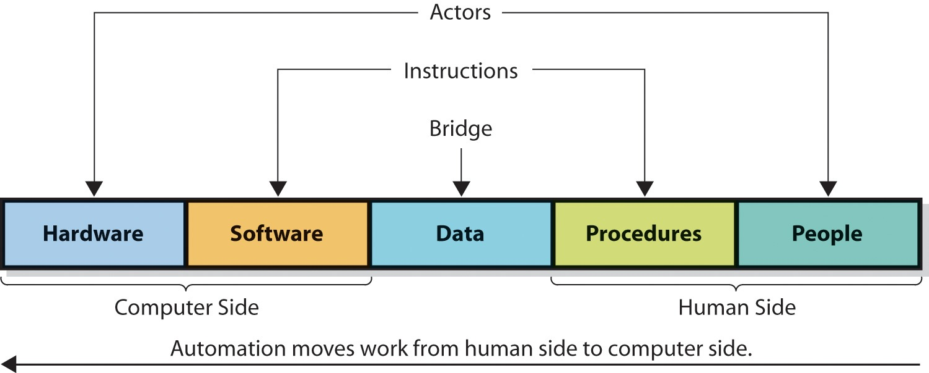
What Does It Mean to Automate a Business Activity?
Insert 2-3

Slide 10
Automation of Business Activity
Actors: People and Hardware
  Can take actions
Procedures and Software
  Follow a set Instructions executed by Actors
  People follow procedures
  Computers follow software instructions
Data is the Bridge
Automation of processes
  Transfer work done by people to computers

Slide 11
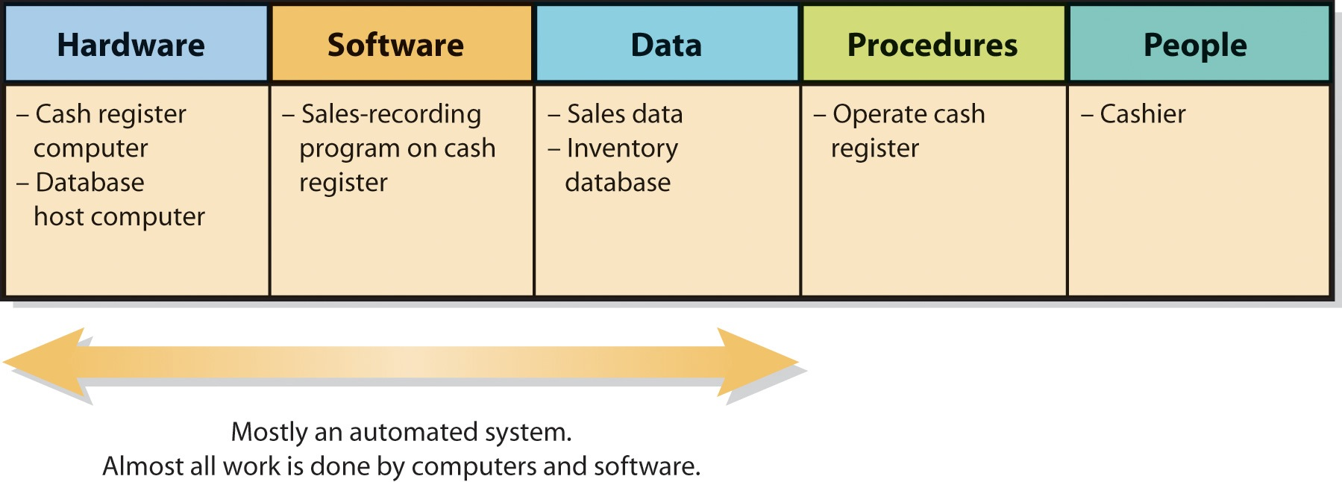
An Example of Automation
(IS Supporting Counter Sales)
Figure 2-4

Slide 12
An Example of Automation
(IS Supporting Counter Sales)
Fully automated
  Cashiers do not require extensive training
  Cashiers do not work directly with programs on computer
Computer in cash register communicates with computer that hosts Inventory Database
Programs record sales and makes changes
Example: transactions at Krogers
  Scanning of each grocery item
  Scanning of loyalty card
  Credit card payment

Slide 13
Organizational IS

Slide 14
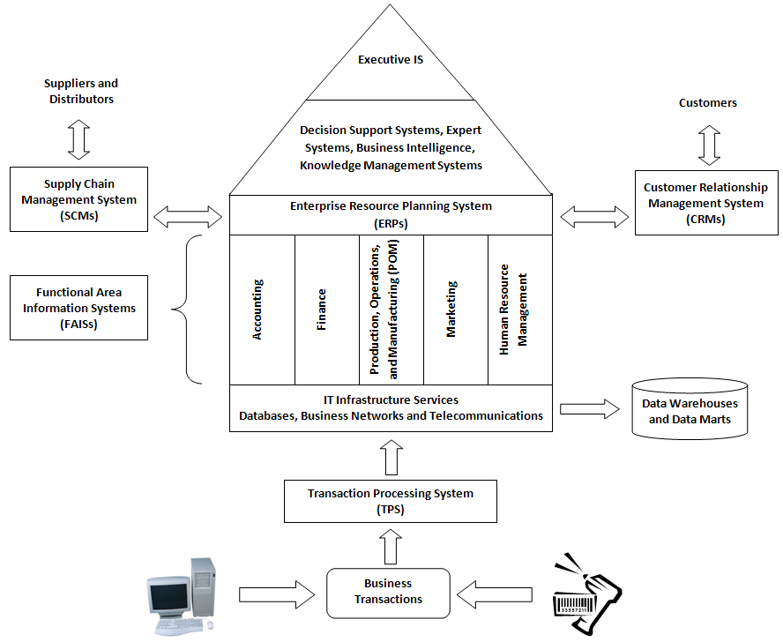


Slide 15
Transaction Processing Systems (TPS)
Transaction
  Any business event that generates data worthy of being captured and stored in a database
TPS
  Organizational IS that collects, stores, and processes data generated from all business transactions
  The data then become inputs to the organization’s databases and then to the Functional Area IS as shown in the diagram on the previous slide
  Why automate TPS data entry?
  Batch Processing vs. Online Transaction Processing (OLTP)

Slide 17
Functional Area IS (FAIS)
FAIS’s Purpose
  Provide information mainly to lower-level and mid-level managers in the critical functional areas of the organization
    Accounting, Finance, Marketing, POMs (production, operations, and manufacturing), Human Resource Management
  Help plan, organize, and control daily operations (or day-to-day activities)
  Create reports (many of which are required by law) to ensure that the company is performing its business processes properly

Slide 18
FAIS
(Reports)
Routine Reports
  Produced at scheduled intervals
  Managers evaluate performance and uncover potential problems
Ad Hoc (on Demand) Reports
  Managers may need special information not included in a routine report or may need information at a different time than scheduled
    Drill-Down Reports that show more detail
    Comparative Reports that compare the performance of different business units, products, employees, etc.
Exception Reports (Management by Exception)

Slide 20
FAIS
(Accounting)
Accounting’s Purpose
  Track every financial transaction
Accounting IS (AIS)
  Accounts payable systems
  Accounts receivable systems
  Payroll systems
  Auditing systems
  Cost Accounting Systems
    Accumulate data about costs involved in producing specific products

Slide 21
FAIS
(Accounting)
AIS
  Are required by law and for proper management
  Are needed to ensure company is making a profit
  Receives information from transaction processing systems (TPSs)
    Automatically routes purchases to accounts payable
    Automatically routes sales to accounts receivable
  Generates financial reports on demand or on schedule
    Balance Sheet
    Income Statement (or profit-and-loss statement)
  Are used by managers for budgeting and cost control

Slide 22
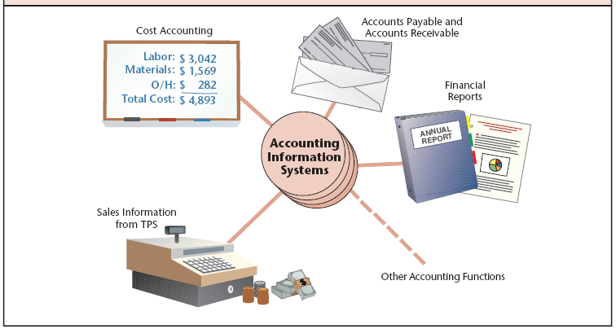
FAIS
(Accounting)

Slide 23
FAIS
(Finance)
Finance’s Purpose
  Manage money as efficiently as possible by:
    Collecting receivables as soon as possible
    Making payments at the latest time allowed
    Ensuring funds are available for daily operations
    Investing funds not used for current activities
Financial IS can improve financial management
  Cash management systems
    Electronic Funds Transfer Systems
  Investment Analysis Systems
    Provides real-time financial news, stock prices, commodity prices, and currency exchange rates
  Financial Planning Systems

Slide 24
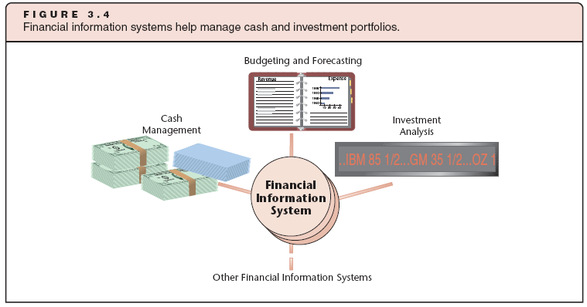
FAIS
(Finance)

Slide 25
FAIS
(Production, Operations, and Manufacturing)
POM’s Purpose
  Produce quality goods and services
  Reduce time to market – the time it takes to turn an idea into a manufactured product ready for consumption
    Generate a product idea, complete a prototype, and manufacture a product
IS can help reduce time to market
  Computer-aided design (CAD) systems
    Tools to create, modify, and store designs and drawings electronically
  Rapid prototyping
    Creating one-of-a-kind products to test design in three dimensions
    Allows a model to be produced in hours rather than days or weeks
  Computer-aided manufacturing (CAM) systems
    Systems that instruct machines how to manufacture parts and assemble products

Slide 26
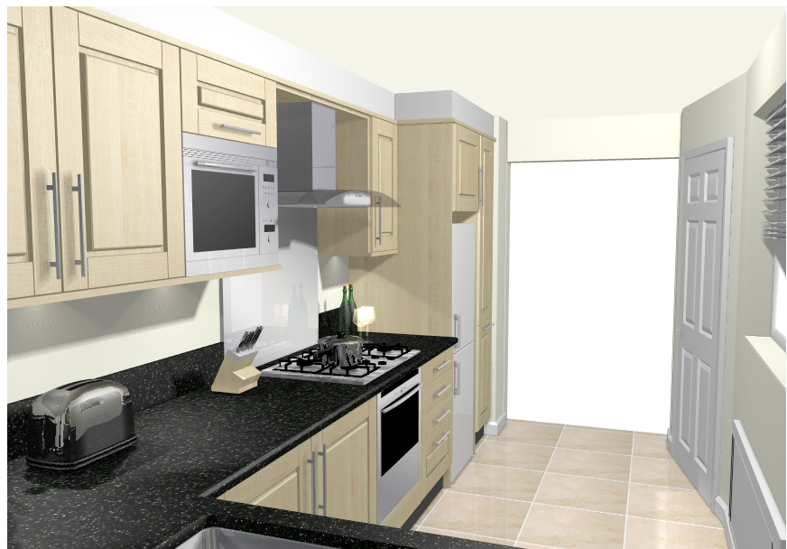
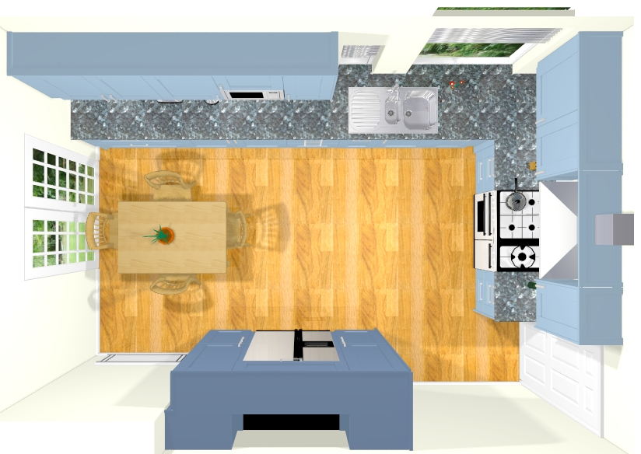
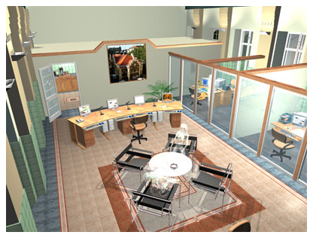
CAD Drawings Examples
(I like Architecture Examples)

Slide 27
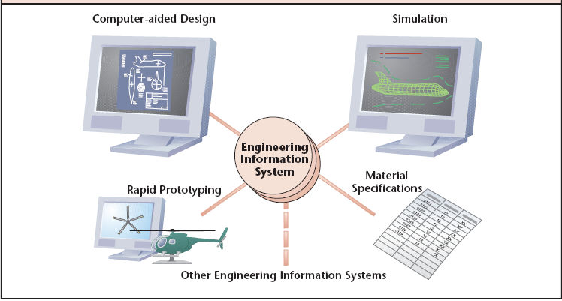
FAIS
(Production, Operations, and Manufacturing)

Slide 28
FAIS
(Human Resource Management)
HR’s Purpose
  Human resource management (HRM) can be classified into five main activities
    Employee record management
    Promotion and recruitment
    Training
    Evaluation
    Compensation and benefits management
IS and the Internet have change HRM dramatically

Slide 29
FAIS (HRM)
Employee Record Management
HR departments must keep personnel records
  To satisfy laws
  For payroll and tax calculation and deposit
  For promotion consideration
  For periodic reporting
Human resource ISs are now digitized
  Saves space to store records, time to retrieve them, and costs of both

Slide 30
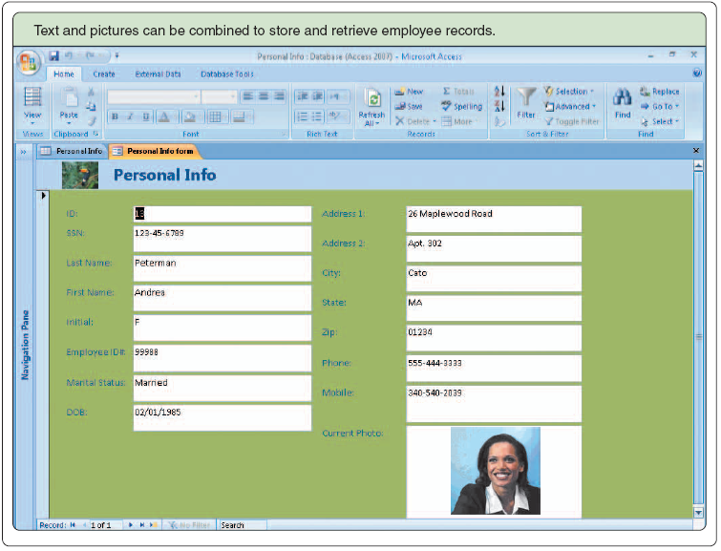
FAIS (HRM)
Employee Record Management

Slide 31
FAIS (HRM)
Promotion and Recruitment
HR can select best-qualified person for position by searching database of applicants and existing employees for specific criteria
  Search employee for records for education, years of service, experience, talents, evaluation ratings, etc.
Automating the selection process significantly minimizes time and money for recruitment
Post job openings on the Internet
  Monster.com

Slide 32
FAIS (HRM)
Training
One important HR function is improving employee skills
Multimedia software training is replacing classrooms and teachers
  May include 3D virtual reality simulated environments in which the employee must act
    e.g., pilot training
IT reduces training costs dramatically
  Can download instructions, processes, and training videos

Slide 33
FAIS (HRM)
Performance Evaluation
Employee ability must be periodically evaluated by supervisors
  May include evaluation of technical ability, communication skills, professional conduct, and general behavior
Often a subjective process, which is a problem
Evaluation software tries to solve this problem by standardizing evaluation process
  Provides tools to aid in evaluating every employee fairly and objectively

Slide 34
FAIS (HRM)
Compensation and Benefits Management
Compensation includes salary, hourly pay, commissions, and bonuses
Programs calculate pay and taxes
  Automatically generate paychecks and perform direct deposits
Software can help manage benefits
  Benefits database accessible through intranet or Internet

Slide 35
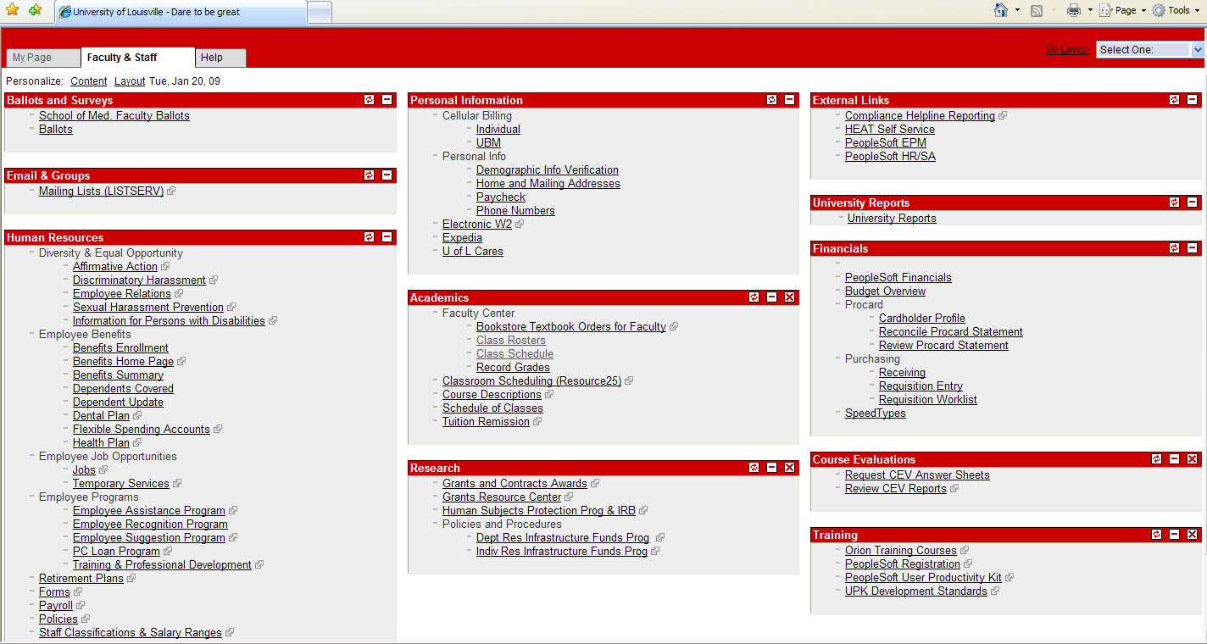
My On-Line HRM at UofL

Slide 36
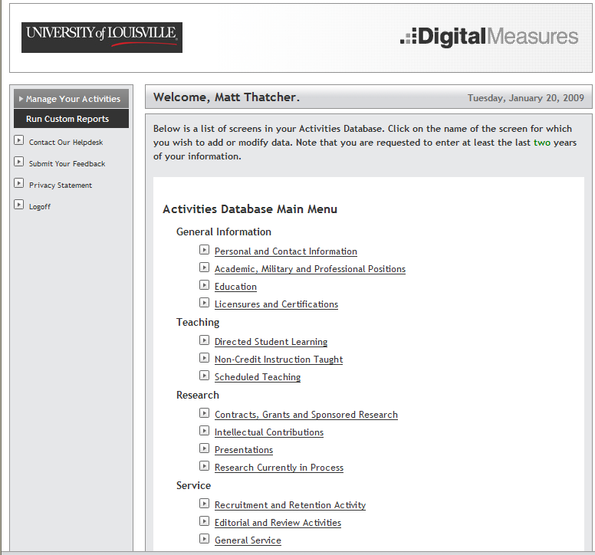
My Performance Evaluation IS
(Digital Measures)

Slide 37
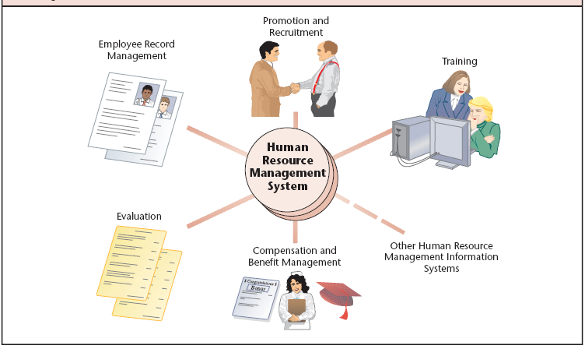
FAIS
(Human Resource Management)
F

Slide 39
Enterprise Resource Planning (ERP) Systems
(The Organization’s Backbone)
ERPs Purpose
  Tightly integrate the FAIS of the organization and to enable information to flow seamlessly across the functional areas
  Manages daily operations
    Managers can now make decisions based on integrate information
  Provides foundation for collaboration among functional areas
Many companies replace old, disparate IS with ERPs
  Companies do not develop and implement their own ERPs
Current ERP market includes four vendors:
  SAP (36%)
  Oracle (24%)
  Microsoft (23%)
  Sage Software (17%)

Slide 40
ERP Systems
ERP software includes modules that support various business processes
  Accounting
  Finance
  POMs
  Sales and Marketing
  HRM
ERP vendors determine what modules and processes to include based on best practices

Slide 41
ERP Systems
(Challenges and Disadvantages)
ERP systems pose many challenges:
  They are complex
  They often require special tailoring for specific organizations (which is difficult to do)
  They may not support a company’s unique sets of business processes
  They are expensive
  A process that becomes a weak link in one area may negatively affect other integrated processes
  Training and change management are difficult and expensive
    Training employees
    Converting data from legacy systems to the new systems

Slide 43
Customer Relationship Management (CRM)
CRM’s Purpose
  Retain and acquire profitable customers
  Designed to support any and all relationships with customers
  Supports three main areas
    Marketing (market research and targeted marketing)
    Salesforce automation
    Customer service
CRM systems capture the entire customer experience with an organization
  All company employees who deal with the customer (customer touch points) have access to this information

Slide 44
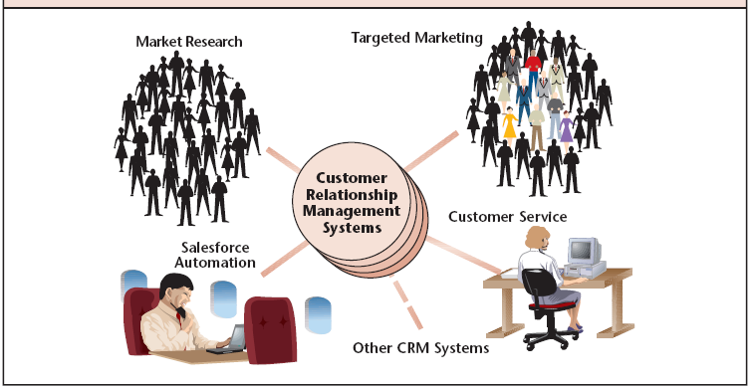
CRM

Slide 45
CRM
(Market Research)
Market Research helps
  Develop customer profiles
  Discover populations and regions that are most likely to purchase products
  Determine what new products these populations want
Activities may include:
  Conducting interviews with consumers and retailers
  Building statistical models to predict sales volumes of different products

Slide 46
CRM
(Targeted Marketing)
Promotes specifically to people most likely to purchase products
Database technology allows all companies to use targeted marketing, even small companies
  Database management systems sort consumers based on demographic information
Can direct promotional dollars to customers most likely to buy

Slide 47
CRM
(Targeted Marketing)
Telemarketing
  Marketing over the telephone
  Caller has large database of consumer data
Computer telephony integration
  Technology that allows the computer to use telephone line as input
  Caller ID can be used to locate customer data
Data mining
  Uses large data warehouses to find trends and shopping habits of various demographic groups
  Remember the examples from Class 1!!

Slide 48
CRM
(Targeted Marketing)
Targeted marketing and Web technologies enable retailers to personalize online shopping
  Software can track Web page click streams to determine customer preferences
  Amazon.com examples
Many of the examples from Class 1 are CRM examples

Slide 49
CRM
(Customer Service)
Web-based customer service provides automated customer service 24/7
  Saves labor costs
  Saves paper costs
Includes FAQs, tracking systems, maintenance of customer profiles
Artificial intelligence may be used to emulate a real-life customer service representative

Slide 50
CRM
(Retention and Loyalty Programs)
Helps organization identify, reward, and market to their most loyal and profitable customers
Advantages of retention and loyalty programs
  It costs 6 times more to sell a product to a new customer than to an existing customer
  A typical customer will tell 8-10 people about her experience
  Odds of selling a product to a new customer are much lower than the odds of selling a product to an existing customer
  70% of complaining customers will still do business with a company if it quickly takes care of a service problem
  Bottom line
    Increasing annual customer retention rate by 5% could lead to a dramatic increase in profits (e.g., 85% increase)

Slide 51
CRM
(Salesforce Automation)
Equips salespeople with IT to improve productivity
  For travelling salespeople → laptops, personal digital assistants (PDAs), and global positioning systems (GPS)
  Think about GEICO Insurance
Makes sales presentations more efficient
Allows salespeople to present different options for products and services at the customer location

Slide 52
Supply Chain Management (SCM)
Supply Chain consists of
  Procurement of raw materials (suppliers - upstream)
  Processing materials into goods (i.e., manufacturing - internal)
  Delivering goods (distribution - downstream)
Supply Chain Management
  Monitoring, controlling, and facilitating supply chains
  Manages interactions with other organizations (i.e., suppliers of raw materials and distributors of our products) and integrates them with internal manufacturing processes

Slide 53
SCM Systems
SCM Systems Purpose
  Increases the quality of information flow through the supply chain
  Reduces time to market, costs, errors, and inventory levels
  Better connect an organization with its suppliers and distributors
IT helps in SCM activities:
  Scheduling plant activities to optimize the use of resources
  Planning material requirements based on current and forecasted demand
  Reallocating materials and resources from one order to another
  Managing inventories
  Grouping similar work orders for efficiency

Slide 54
How Do Decisions Vary by Level?
Decisions occur at three levels
  Operational
    Day-to-day activities
      Which invoices should we pay today?
      What inventory do we need to order to restock the shelves?
      Supported by TPS, FAIS, and ERPs
  Managerial
    Allocation and utilization of resources
      What combination of people and skills do we need for Project A?
      Supported by FAIS, ERPs and DSS
  Strategic
    Broader-scope, organizational issues
      UPS – Do we need to buy a fleet of 5 new aircrafts by 2010?
      Should we take this company over?
      Should we outsource our entire IT function?
      Supported by DSS and Executive Information Systems
Operational decisions involve shorter timeframe

Slide 56
Summary
Define
  Efficiency, effectiveness, and productivity
  How does IS affect these three performance metrics?
  What does it mean to automate a business activity?
    Think about the 5 components of an IS
Describe
  TPS
  FAIS and the support they provide for each functional area of the organization
    Accounting, Finance, Marketing, HR, POMs
    Types of reports
  ERP systems
  CRM systems
  SCM systems

Slide 57
Summary
Describe the relationship among these different organizational IS
  You should be able to draw (or interpret) a diagram summarizing the relationships
  Look back at the diagram of the organizational system that I presented in this class

Slide 58
Stop Tegrity!

